Slide 1
MINIMALLY INVASIVE LUMBAR SPINE SURGERY

Slide 2
Minimally Invasive Lumbar Spine Surgery
What is MISS ?

Slide 3
Minimally Invasive Lumbar Spine Surgery
Minimize tissue trauma and blood loss
Minimize post-operative pain
Minimize hospital stay
Minimize recovery
But not at the expense of surgical success or morbidity

Slide 4
Keys to Minimally Invasive Spine Surgery
Smaller incisions
Muscle splitting instead of muscle cutting
Fluoroscopic and image-guided navigation

Slide 5
Minimally Invasive Lumbar Spine Surgery
Lumbar Discectomy
Instrumentation
AIIMS Ex.

Slide 6
Clinical Example. 1

Slide 7
Percutaneous Lumbar Discectomy
1975 Hijikata
Indications
Failure to respond to non operative measures
Correlative pain distribution
Positive tension signs
Correlative radiological studies
With or without neurological deficits
Contraindication
Cauda Equina Syndrome
Hijikata S, Yamagishi M, Nakayama T, Oomori K: Percutaneous diskectomy: A new treatment method for lumbar disc herniation. J TodenHosp 39:5–13, 1975.

Slide 8
Percutaneous Lumbar Discectomy
Small caliber cannula
Dorsolateral insertion
Positioned in the SAFE zone
Quick look at the canal content
Annulotomy
Disc extraction

Slide 9
Percutaneous Lumbar Discectomy
Results
Davis 1991 , 518 pt
Success rate – 87%
Conclusion
Can be done for single level discs
Role remains investigational and needs RCT validation of outcomes
Davis GW, Onik G, Helms C: Automated percutaneous discectomy. Spine
16:359–363, 1991

Slide 10
Arthroscopic Discectomy
2.7-mm glass arthroscope combined with a video discoscope with a single working portal
Arthroscopic disc surgery allows removal of herniated discs via a posterolateral approach
Allow inspection of the annulus, spinal nerve, and foramina
Kambin , reported an 87% successful outcome rate with arthroscopic microdiscectomy

Slide 11
PERCUTANEOUS LASER DISCECTOMY
Ascher and Heppner , in Germany, used carbon dioxide and neodymium lasers in neurosurgery
Combined results of Ascher, Choy et al. , and others demonstrated 70 to 80% rates of long-lasting pain relief for more than 1000 patients
Lasers used :
1. Carbon dioxide
2. Nd - YAG Laser
3. Potassium-tytinal-phosphate (KTP) laser
Choy et al 333 patients, with a mean follow-up period of 26 months, reported a 78.4% success rate
No controlled prospective studies have been performed
Choy DS, Ascher PW et al: Percutaneous laser disc decompression: A
new therapeutic modality. Spine 17:949–956, 1992.

Slide 12
PERCUTANEOUS INTRADISCAL RADIOFREQUENCY THERMOCOAGULATION
Vaporization of the nucleus pulposus
Lesions are produced at probe temperatures of 60 to 80°C.
Two different mechanisms i.e. thermal coagulation of nociceptors and contraction of collagen Type I fibres, increasing the stability of the disc
Results: 60% of the selected patients experienced profound reduction in pain

Slide 13
Percutaneous Lumbar Discectomy
Advantages
Nerve roots and thecal sac not retracted
Peri/epidural scar formation minimal
Supportive myeloligamentous structures are not disturbed
Post –op stay/cost/morbidity minimized.
Disadvantages
Learning curve
Unable to address migrated disc fragments
Unable to address bony or ligamentous pathology

Slide 14
LUMBAR MICROENDOSCOPIC DISCECTOMY
Sofamor Danek developed the instruments and technology.
Combines standard lumbar microsurgical techniques with endoscopy
A significant difference in mean operative blood losses
There was a significant difference in the mean number of days of hospital stay
Significant decrease in analgesic use
Muramatsu K, Hachiya Y, Morita C: Postoperative magnetic resonance
imaging of lumbar disc herniation: Comparison of microendoscopic discectomy and Love’s method. Spine 26:1599–1605, 2001.

Slide 15
The MED system is an endoscopic system that enables posterior lumbar discectomy through a tubular retractor, with endoscopic observation
Guide wire is inserted with the tip being fluoroscopically directed to the operative disc space.
Dilators are sequentially inserted at the junction of the lamina and the lateral mass.
16-mm tubular retractor is then inserted over the largest dilator and fixed to the flexible arm assembly on the table
Endoscope is fixed inside the tubular retractor
Bone removal is performed with a small Kerrison punch or a high-speed drill

Slide 16
SPINAL ENDOSCOPY
FDA-approved indications for the use of spinal endoscopy are as follows:
documentation of pathological feature
documentation of decompression of structures
direct nerve inspection
inspection of internal fixation and delivery of therapeutic agents

Slide 17
LAPAROSCOPIC LUMBAR SURGERY
LUMBAR SPINAL FUSION
In 1991, Obenchain, reported the first use of a laparoscopic approach to the lumbar spine, for a discectomy
Mathews et al, laparoscopic anterior lumbar fusion
Dural injury and epidural scarring can be avoided
Retroperitoneal approach to the lumbar spine was first described by Iwahara (45) in 1963
Indications
spondylolisthesis
degenerative disc disease
internal disc derangements
instability and for reoperations
Retroperitoneal, minimally invasive, endoscopic spine surgery has the advantages of not requiring carbon dioxide insufflation or entrance into the peritoneal cavity and avoids dissection near the large vessels and the hypogastric plexus

Slide 18
MINIMALLY INVASIVE PERCUTANEOUS POSTERIOR LUMBAR INTERBODY FUSION
METRx instrumentation and operating room set-up showing:
A. METRx endoscope with disposable clamp
B. flexible arm retractor
C. Steinman pin and dilators;
D. skin level tubular retractors
E. modular system consisting of monitor, video integrator, recorder, and video printer with cart
F. operating room set-up for endoscopic lumbar discectomy using lateral fluoroscopy and two video monitor
G. operating room set-up using microscopic visualization.

Slide 19
Sequential operative procedure for endoscopic discectomy.
Schematic drawing demonstrates area to dock Steinman pin.
Lateral fluoroscopic image shows K-wire docked on laminofacet junction.
Illustration shows properly placed dilators.
Photograph illustrates dilators in place and METRx tubular retractor locked in place
Lateral fluoroscopic image shows METRx tube in appropriate position.
Illustration demonstrates endoscopic drilling of lamina.
Illustration demonstrates proper positioning of METRx-MD tubular retractor.

Slide 20
Minimally invasive PLIF/Pedicle Screws
Same final result as open procedure
Much less destructive:
Shorter skin incision
Minimal muscle trauma
No significant soft tissue retraction
Less pain
Shorter post-operative hospital stay

Slide 21
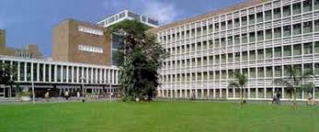
AIIMS Experience
Sarkari.A, Gupta.D, Mahapatra.A.K: Minimally Invasive Spine Surgery in Acute Dorso-Lumbar Trauma: An Experiences of 14 Cases, IJNT, Dec-2011
Prospective study
February 2009 to February 2011
Jai Prakash Narayan Apex Trauma Centre, AIIMS, New Delhi

Slide 22
AIIMS Experience
14 patients: 10 male 4 female
Age: range 17-47 years (mean 30.1 ± 7.9 yrs)
Modified Frankel neurological performance scale (ASIA)
E = 2
D = 11
A = 1
Mean TLCIS: 5.2 ± 0.6
Interval b/w injury and surgery: 1 – 18 days (5.5 ± 4.3 days).

Slide 23
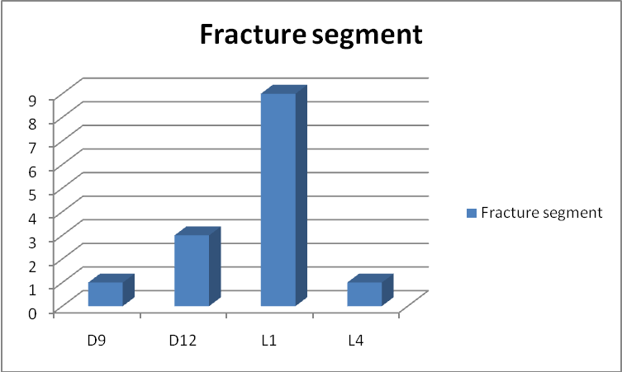
AIIMS Experience
No. of cases
1
3
9
1

Slide 24
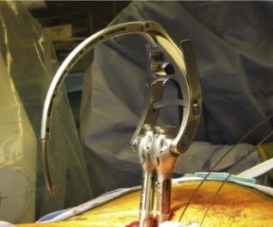
AIIMS Experience
C-arm fluoroscope: 12 cases
‘O-arm’ Computer assisted virtual fluoroscopic system : 2 cases
Medtronic Sextant System was used for PSRF in all the patients

Slide 25
AIIMS Experience : Results
Complete procedure was successfully done percutaneously in 12 cases
Total of 60 screws were put
Blood loss ranged from 50 to 150 ml (mean 94 ± 16 ml)
2 patients needed conversion
2 (out of 60) screws misplaced

Slide 26
VARIABLE | PERCUTANEOUS | OPEN | P- Value
No. of cases (n) | 14 | 207 | -
Operating time (minutes) | 95 ± 34 | 183 ± 57 | 0.0428 Significant
Blood loss (ml) | 94 ± 16 | 458 ± 176 | 0.0078 Significant
Hospital stay (days) | 3.8 ± 2.3 | 8.2 ± 3.9 | 0.0102 Significant
Screw malposition | 3.3% | 7.8% | 0.0489 Significant
Infection rate | 7.14 % (n=1) | 6.73 % (n=14) | 0.146 Not significant
Improvement in VAS at discharge | 72.1 % | 34.8 % | 0.0167 Significant
Improvement in degree of kyphosis | 72.8 % | 78.8 % | 0.06 Not significant

Slide 27
STUDY | Foley et al (2001) | LEE et al (2004) | Schwender et al (2005) | Birrouneau et al (2011) | Present (2011)
N | 12 | 17 | 47 | 24 | 14
Operating time (min) | 90- 220 | 107.6 | 112.5 | 99 | 95
Blood loss (ml) | 118 | - | 140 | - | 94
Post-op complications | 8.3 % Op site hematoma | - | - | 12 % Op site hematoma | 7.14 % Infection
improvement in VAS % | - | 70.8 % | - | 75.3% | 72.8%
Malpositioned Screws | 2.1 % | 4 % | - | 1.8 % | 3.3 %
Good to excellent outcome % | 91.1 % | 85 % | 89.4 % | 93 % | 84.6 %

Slide 28
AIIMS Experience
Percutaneous pedicle fixation
Safe and efficacious in the setting of acute polytrauma with spinal fracture requiring ligamentotaxis.
Reduces hospital stay (mean 3.8 days) and improves functional outcome in patients (mean VAS 2.2 post-op v/s 7.9 pre-op)
Useful in select cases
Steep learning curve involved.

Slide 29
Thank You

